Slide 1
Digi XBee 3 802.15.4 RF Radio Modules with MicroPython

Slide 2
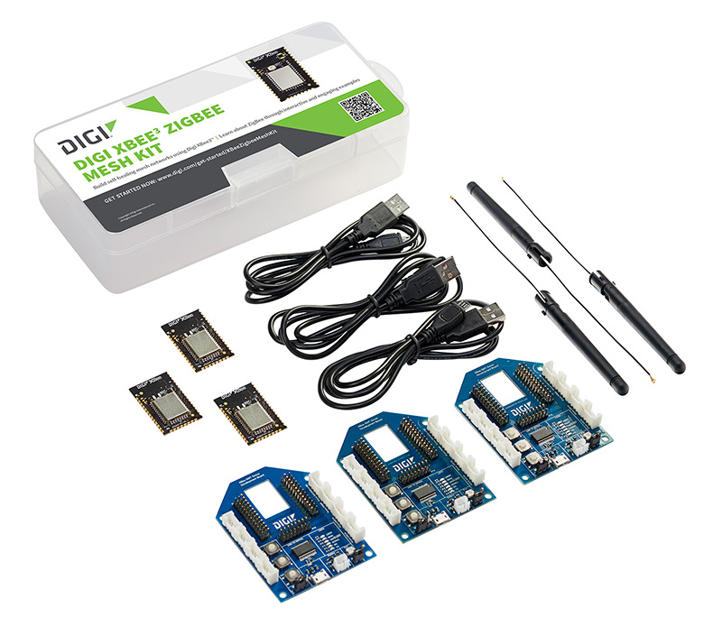
Digi XBee3 ZigBee Mesh Kit
3 XBee3 ZigBee SMT RF Modules
3 XBee3 SMT Grove Development Boards
3 USB cables
3 Antennas
SMT=Surface Mount (form factor of RF module)

Slide 3
Software für die Laborübungen
XCTU: https://www.digi.com/products/embedded-systems/digi-xbee/digi-xbee-tools/xctu
PyCarm mit XBee MicroPython PlugIn: https://www.jetbrains.com/de-de/pycharm/
Python: https://www.python.org/downloads/ mit XBee Python library "digi-xbee"

Slide 4
Documentation
PDFs on Moodle:
Digi XBee3 ZigBee RF Module User Guide
your first reference
covers all aspects regarding the XBee3 ZigBee module
Digi MicroPython Programming Guide
intro to MicroPython for XBee3 (not only for ZigBee)
Digi XBee3 802.15.4 RF Module User Guide
only if you use the XBee 3 as 802.15.4 module (labs one and two)
Digi XBee3 RF Module Hardware Reference Manual
information on hardware layout and pins
Digi XBee Grove Development Board User Guide
information on connectors of the development board
pins
Web Pages
https://www.digi.com/resources/documentation/digidocs/90002219/default.htm
https://xbplib.readthedocs.io/en/latest/index.html
https://github.com/digidotcom/xbee-micropython
https://docs.micropython.org/en/latest/index.html

Slide 5
XBee3 – Operating Mode
The Operating Mode defines how the XBee3 devices communicates with the PC via UART via USB
the communication over radio always uses 802.15.4 radio frames
communicating XBee3 devices may use different Operating Modes
transparent mode (AT)
data mode
command mode
API mode
MicroPython
transparent mode (AT)
data mode
command mode
API mode
MicroPython
Operating Modes
PC
USB (UART)
XBee
802.15.4 radio frames
XBee
USB (UART)
PC
802.15.4
ZigBee
802.15.4
ZigBee
Software
XCTU
Python
Putty
Software
XCTU
Python
Putty

Slide 6
XBee3 – Transparent Mode (AT) – Data Mode
Bytes are buffered and packed into radio frames
Payload of radio frames goes to Serial interface
PC
USB (UART)
XBee
802.15.4 radio frames
XBee
USB (UART)
PC
UART over 802.15.4
XCTU: displays
chars
XCTU: just type chars

Slide 7
XBee3 – Transparent Mode (AT) – Command Mode
PC
USB (UART)
XBee
802.15.4 radio frames
XBee
USB (UART)
PC
AT commmands to
read and write parameters
trigger actions
enter command mode with „+++“
return to data mode after period of silence
AT commands in Digi XBee® 3 Zigbee® RF Module

Slide 8
XBee3 – API Mode
PC
USB (UART)
XBee
802.15.4 radio frames
XBee
USB (UART)
PC
API frame of different type to
transmit 802.15.4 radio frame
send AT command
…
API frame of different type to
receive 802.15.4 radio frame
get response to AT command
…
PC
USB (UART)
XBee
802.15.4 radio frames
XBee
USB (UART)
PC
802.15.4 radio frame
Tx Request API frame
contains 802.15.4 radio frame
Rx Packet API frame
contains 802.15.4 radio frame
In XCTU: use frame generator tool

Slide 9
XBee3 – MicroPython via XCTU
PC
(XCTU)
USB (UART)
XBee
802.15.4 radio frames
XBee
USB (UART)
PC
(XCTU)
Python Instruction
Python Instruction
MicroPython Terminal
MicroPython Interpreter
MicroPython Interpreter
MicroPython Terminal
return value
return value
PC
USB (UART)
XBee
802.15.4 radio frames
XBee
USB (UART)
PC
xbee.transmit
(destination,payload)
802.15.4 radio frames
xbee.receive()
Interpreter
+ XBee Libraries
Interpreter
+ XBee Libraries
Terminal
Terminal
source, payload
as dictionary

Slide 10
XBee3 – MicroPython via PyCharm PlugIn
USB (UART)
802.15.4 radio frames
USB (UART)
PC
XBee
XBee
PC
(XCTU)
Upload
Python Code
Upload
Python Code
PyCharm
Execute Python Code
Execute Python Code
PyCharm
STDOUT
STDOUT

Slide 11
XBee3 – Python
PC
USB (UART)
XBee
802.15.4 radio frames
XBee
USB (UART)
PC
API frame of different type to
transmit 802.15.4 radio frame
send AT command
…
API frame of different type to
receive 802.15.4 radio frame
get response to AT command
…
PC
USB (UART)
XBee
802.15.4 radio frames
XBee
USB (UART)
PC
Tx Request API frame
802.15.4 radio frame
Rx Packet API frame
send_data_16
(destination, payload)
xbee_message = device.read_data()
(from UART)
Python
Python

Slide 12
XCTU – First Configuration and First Communication
connect the three XBee modules to the PC
upload the newest firmware
configure all devices to API mode
configure one device as coordinator (forming network), the others as router/end device (joining network)
configure the intended PAN ID
check "Operating Network Parameters" until association is successful
go to console and try sending packets
send broadcast packets (64-bit=00 00 00 00 00 00 FF FF, 16-bit=FF FE)
send direct packets (set 64-bit and 16-bit address)

Slide 13
XCTU Configuration Parameters
MM (MAC Mode):
must be equal for devices to understand each other‘s frame
you won‘t see a difference, XCTU range test only with Digi header
PS (MicroPython Auto Start):
specifies whether MicroPython code on the device starts automatically after start-up
turn off or upload empty script if you do not use the device with PyCharm plugin
turn on when you want to use your device remotely i.e. not connected to a computer
BD (UART Baud Rate): defines the Baud rate over the USB
default with 9600 Baud is less than data rate over the radio interface and thus the bottleneck
you may want to set higher values but be careful to remember when connecting the device again
D4: User LED
you use this for the user LED examples
DB (Last Packet RSSI): not configuration but information
yields the RSSI (received signal strength indicator) for the last packet
required for you own range test

Slide 14
XCTU - MicroPython
switch to MicroPython mode (configure AP parameter)
start MicroPython terminal (under Tools), press return and the Python prompt should appear
try some small commands
print something
blink the user LED (GPIO 4/Pin 4)
https://docs.micropython.org/en/latest/library/machine.Pin.html
"MicroPython Modules" in MicroPython Guide
transmit a frame and display it by XCTU
"Get started with MicroPython" section in the XBee3 ZigBee RF Module User Guide
"XBee device examples" in the MicroPython Guide
receive a frame transmitted by XCTU
"Get started with MicroPython" section in the XBee3 ZigBee RF Module User Guide

Slide 15
Upload MicroPython – PyCharm PlugIn
install PyCharm and XBee MicroPython PlugIn
"Use the PyCharm plugin" in the MicroPython guide
repeat the three examples from before
use the existing XBee MicroPython sample projects
combine the examples and control the blinking frequency of the user LED by sending messages from XCTU

